Slide 1
ZapLok Pipe Joining Technique
Khlefa Esaklul
&
Cynthia Landry
Asset Integrity
Worldwide Engineering and Operation

Slide 2
Introduction
Zap-Lok® is a pipe joining technology which relies on elastic strain and surface friction to join pipes.
The connection consists of a “bell” (expanded end) into which a “pin” (the straight end of the adjoining pipe) is forcefully inserted to provide an interference fit.
It was first considered because it can be internally coated to prevent corrosion problem because joints can be internally coated prior to being connected, and coating integrity can be maintained throughout the connection and installation process,
Zap-Lok eliminates the need for coating repair at welds.
A technology qualification process (TQP) was performed in order to determine the limitations of this technology.
The qualification plan included full-scale stress testing and finite element analysis (FEA),
Sour service testing per NACE TM0177, crevice corrosion testing at the joint,
Cathodic protection (CP) testing, and a historical review of previous Zap-Lok® installations.

Slide 3
Introduction
Full-scale testing and FEA confirmed that there are limitations regarding the axial capacity of the joint. While most codes (ASME B31 codes) do not limit axial capacity for welded joints it is necessary to perform an axial stress check on when using Zap-Lok®.
The Zap-Lok® TQP includes a specification for Zap-Lok® use, which includes the details of the necessary joint length and required stress checks.
Sour service testing in accordance with NACE TM0177 concluded that Zap-Lok joints has low susceptibility to sulfide stress cracking (SSC), and therefore may be used in sour service, provided that the bell of the Zap-Lok® joint is heat treated in accordance with NACE MR0175/ISO 15156-2003 (after belling), and that the base pipe is ordered in accordance with CES PPL 1050-2008.
Crevice corrosion testing determined that the joint material is not susceptible to crevice corrosion. Through conductivity testing, it was determined that standard weldedline CP practices may be used for Zap-Lok® joints.
Additionally, there have been no failures of Zap-Lok® due to ineffective CP to date.
Experiences and lessons learned were gathered from 28 different Zap-Lok® users, which indicates a good history with most problems generated from incorrect installation
The TQP performed on Zap-Lok® joints effectively identified the limits and applicability of this technology for Chevron Thailand Exploration and Production Ltd.
The first installation of subsea Zap-Lok® was performed in Thailand in 2011 with no reported problems.

Slide 4
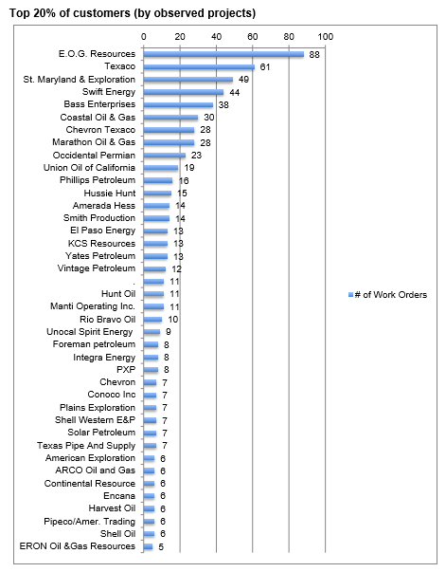
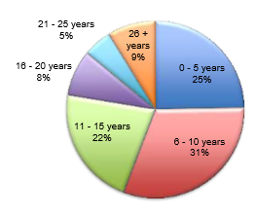
Zap-Lok Users

Slide 5
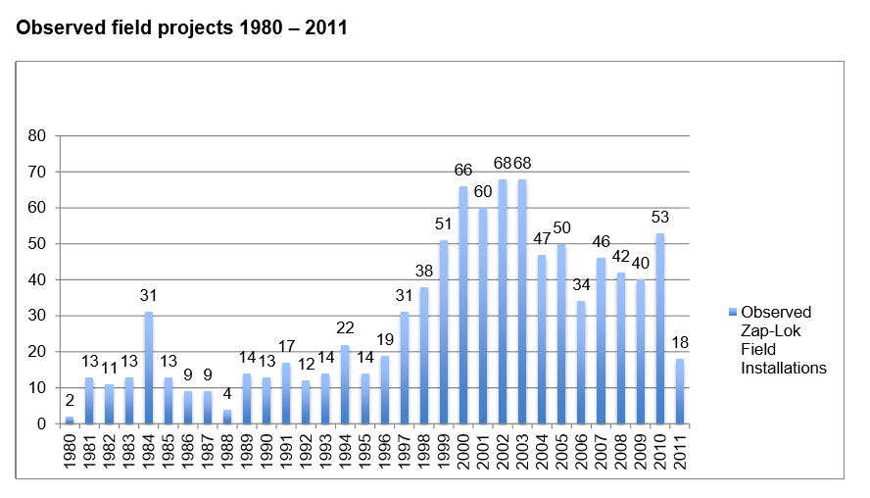
Zap-Lok Installation Projects

Slide 6
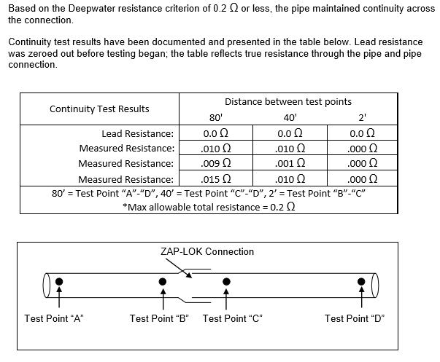
CP Concerns

Slide 7
OXY Experience per NOV (2007 – 2012)
In the 5 years (2007 – 2012) Oxy has installed 3,973,394 feet (1211 Km) of Zap-Lok end-prepped pipe, but has been using the Zap-Lok connection process since 1989. Oxy has also acquired and now operates lines that were originally installed by Marathon Oil and Santa Fe Energy.

Slide 8
Zap-Lok Characteristics
Pressure rating is the same as the parent pipe so is calculated as a percentage of the maximum allowable wall stresses. At 12" up to X52, 0.500"wt so the MAOP as per ASME would be; 0.72 x (52,000 x 2 x 0.500 / 12.75) = 2,936psi or ANSI class 1500.
Installed the joint from 2 - 12" offshore so obviously the rating goes up as the d/t ratio increases.
Size all sizes have been used offshore but the most common is 8,10,12" sch. 80
Wall thicknesses, most commonly sch. 40 or 80 or thereabouts
The lay method is S-lay. The joint is most suited to this to reduce tension, bending and it is far quicker as well as cheaper if a suitable vessel is chartered (i.e. MSV/PSV or DP2 workboat)
The main locations for offshore installation have been the GOM and West Africa (Gabon and Cameroon) however we are extending this to projects in the North Sea and Malaysia.
Basically the joint can be considered to have a DNV F2 fatigue curve, although Shell consider it to have the same performance as a D class weld. This precludes it from use as a riser or in VIV situations but it is fine for a flowline.

Slide 9
Objective
- Target ~15% TIC cost savings for 316SS/SSL S40 lines (~8$/ft savings)
- Determine if the testing results merit a pilot project

Slide 10
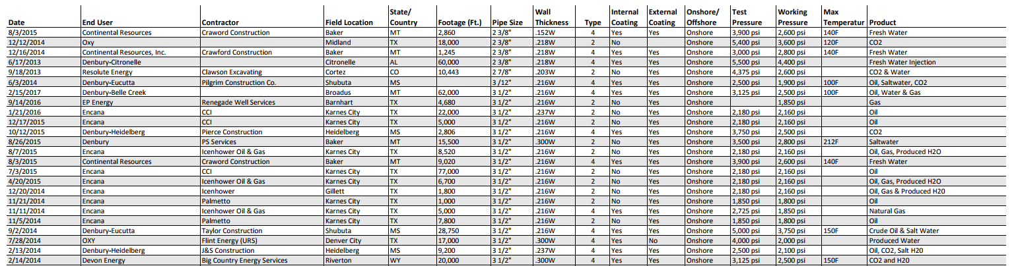
High Pressure Zaplock Reference
This is a sample of installations, further evidence available on request
Notes:
OXY Resources is highlighted

Slide 11
Initial Hydrotest of 316SS/SSL piping and CS
ALL JOINTS WERE WELDED WITH END CAPS AND PRESSURED UP TO FAILURE.
EACH SAMPLE SEPARATED AT THE CONNECTION. NO BODY WALL FAILURES WERE OBSERVED ON THIS TEST.
Test performed by CPS Houston 7/25/17

Slide 12
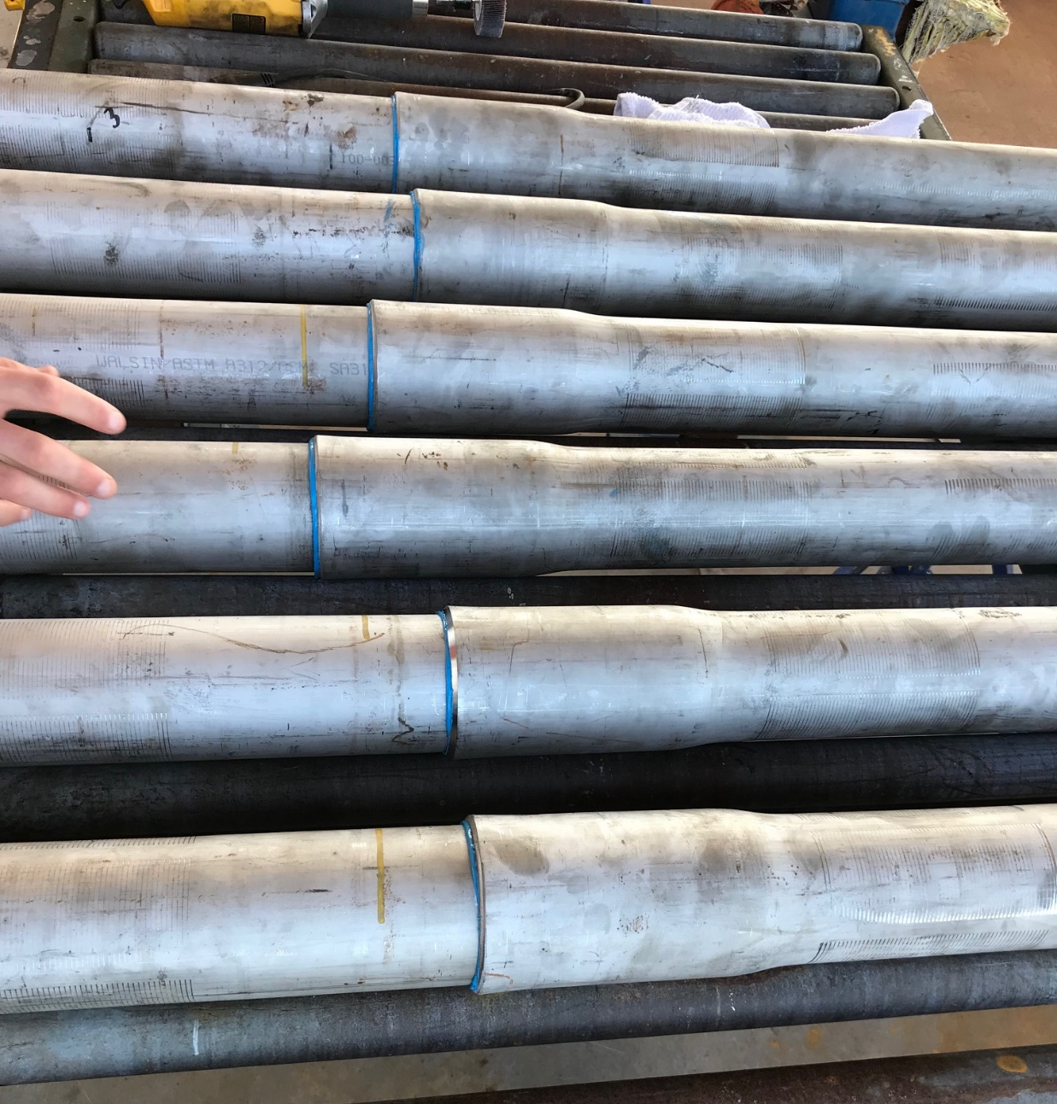
Fabrication Test
Created six (6) 3” 316SS/SSL S40 ASTM A312 EFW Zaplock Test Joints
Created three (3) Carbon Steel S40 Zaplock Test Joints
Witness and measured make-up of bells and pins
Recorded Hydraulic pressure associated with joint make-up
Fabrication completed by NOV on 10/6/17

Slide 13
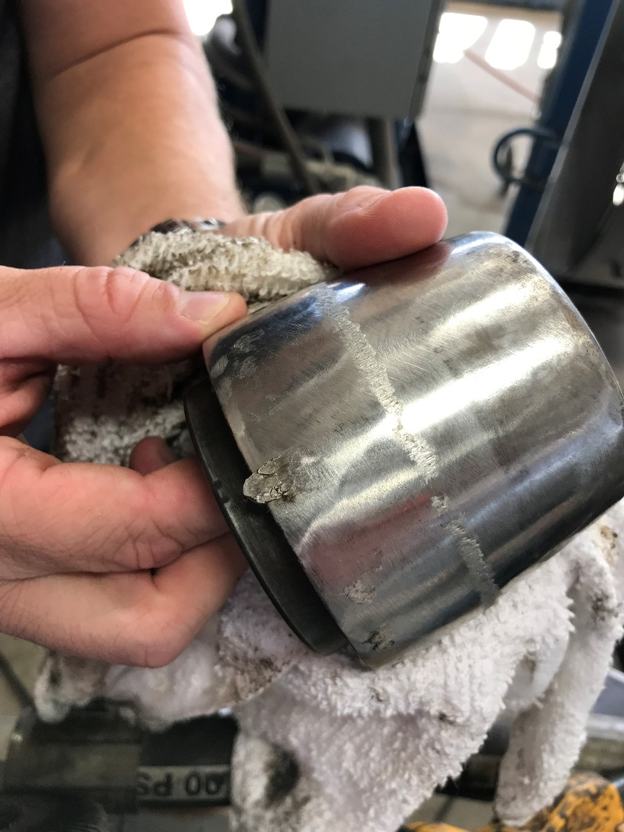
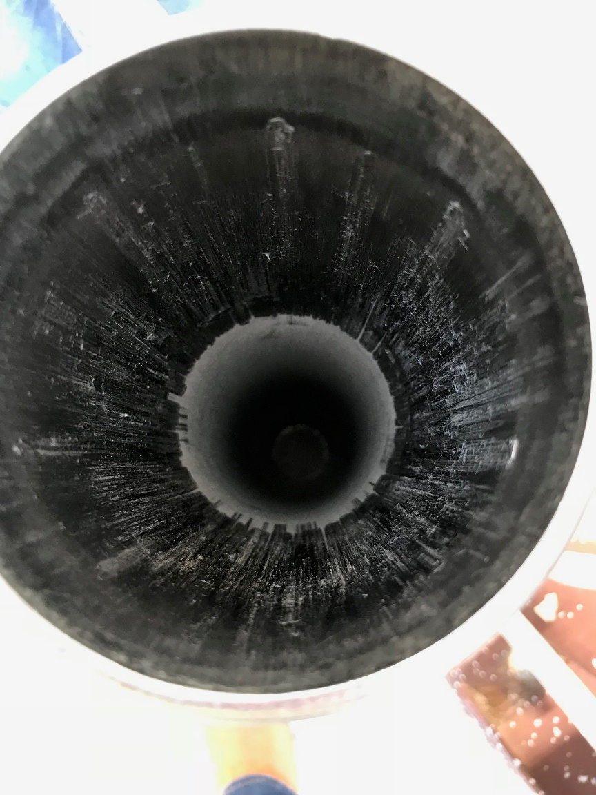
Fabrication Photos

Slide 14
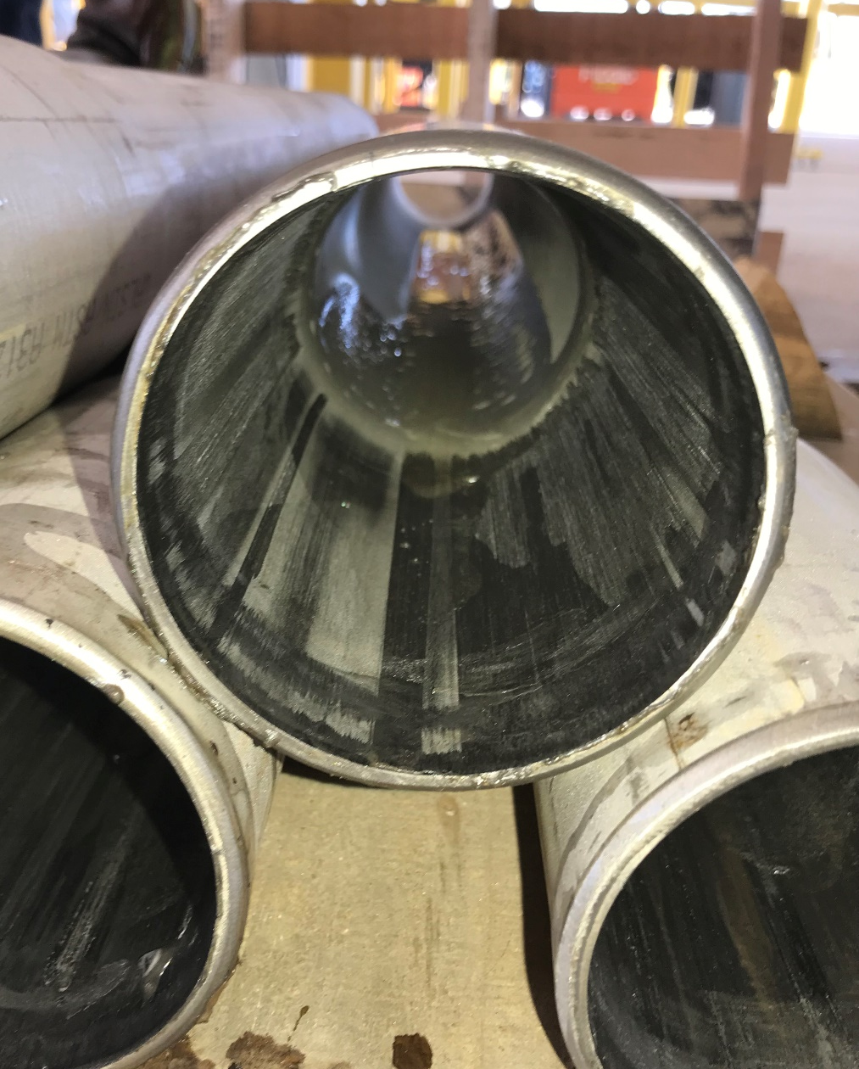
Fabrication Lesson Learned
Severe galling found in initial joints (using carbon steel best practices)
Lessons Learned
Lubricate the inside of the pipe prior to the bell process
Clean any burs on the end of the pipe
Utilize the correct die in bell making process
Use copious amounts of lubricant (compared to CS)
CS Fabrication Clamps embedded CS in the SS material (Can be overcome with hard tool steel clamps)

Slide 15
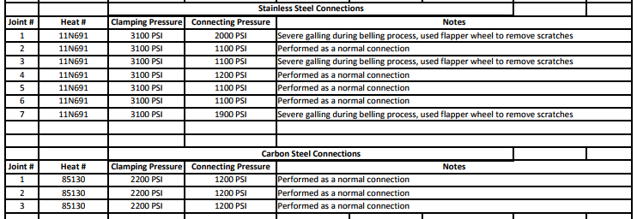
Fabrication Test – Results Hydraulic Pressure
Notes:
Note the higher connecting pressure for the galled piping

Slide 16
Follow Up Hydrotesting
- ALL (6) SAMPLES WERE PRESSURED UP AND SEPARATED AT THE CONNECTION
- NO BODY WALL OR WELD SEAM FAILURES WERE OBSERVED.

Slide 17
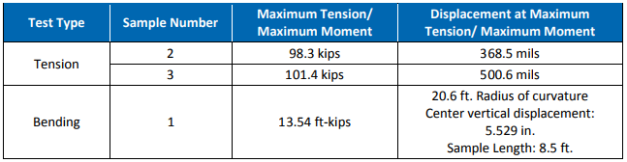
Stress Engineering Testing
- Both Test Samples separated during the tensile test (pin and bell separation) as expected
- Bend Test exceeded the yield strength of the pipe per the MTR. The connection did not separate

Slide 18
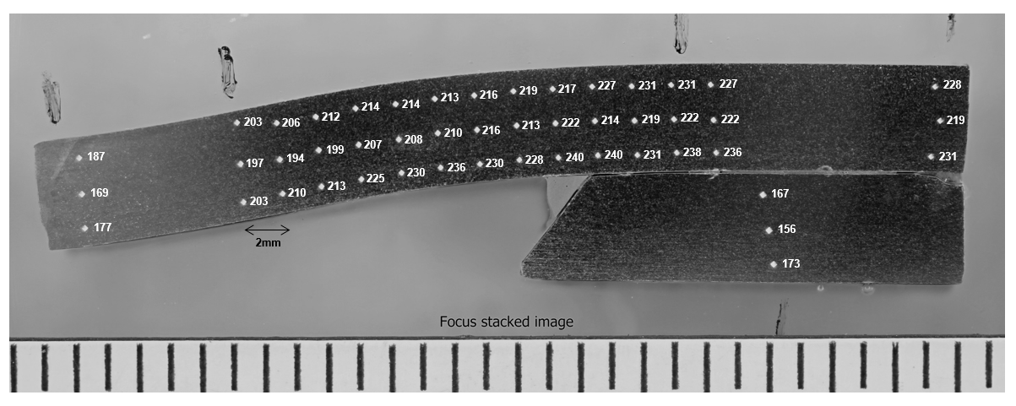
Hardness
Results of Vickers hardness (HV10) testing performed on metallographic cross-section CS01. Locations of indents and corresponding hardness readings shown in diagram below. Scale shown in 1/16 inch increments.
Notes:
Cross section of Joint
Hardness not of concern for Khlefa

Slide 19
EVALUATING THE PERFORMANCE OF THE ZAP-LOK CONNECTION SYSTEM
The Zap-Lok connection was originally conceived to solve a welding problem that involved “burn through” on thin wall pipe used for transporting low pressure gas to market.
It was soon adapted for joining internally plastic-coated steel pipe for a larger number of applications.
Full-scale testing has been used to validate the design of the Zap-Lok connection and ensure that it meets the minimum requirements set forth by pipeline companies.
The general observation from the multiple test programs that have been completed is that the tested Zap-Lok connections are able to achieve loads equal or exceed the Specified Minimum Yield Strengths of the tested pipe grades.
Additionally, the integrity of the Zap-Lok connection is able to withstand loads associated with offshore pipe lay operations in water depths up to 400 feet.
Proceedings of IPC2010 8th International Pipeline Conference September 27 – October 1, 2010, Calgary, Alberta, Canada

Slide 20
Zap-Lok Design conditions as stated by Major IOC
Fatigue Strength – performance comparable to an F2 weld as per BS 7608.
Sour service testing as per NACE TM0177 Method A – Bells must be heat treated as per NACE MR0175, i.e., heated to 1,100°F for 1hr/inch wall thickness then tested for hardness. Whilst similar to PWHT this operation is conducted in the yard and does not encumber installation.
Crevice corrosion (exposed for 1 month at 130°F and 500psi in brine with 1,000ppm acetic acid, 30% CO2, 70%N2 – deemed not to be a concern.
Cathodic Protection (CP) – electrical continuity maintained across the joint.
Procedure issued covering jointing of API 5L pipe, 4-10” NPS, grades X42 to X60.

Slide 21
Zap-Lok Design Cont.
Onshore and Offshore to 300m water depth
2 to 12-inch, 0.25 to 0.5” wt, grade X52-X60
Not for use where it could be exposed to Vortex Induced Vibration (VIV)
Axial Stress to be limited to 80% of allowable per code
Sour Service, with end heat treated prior to joining
Internal corrosion coating

Slide 22
Zap-Lok Design Cont.
Burst Strength
Testing showed that the burst limit state often involved separation of the connection, not a fish mouth opening that occurs with welded pipes.
Unlike welded connections, Zap-Lok® connection tended to pull out at the pressure containment limit state.
Bend Strength
Five samples were subjected to bending cycles with and without internal pressure.
The Zap-Lok® connection did not separate when bent to a large angle (>100º/100 ft), and no loss of internal pressure was observed.
Leak tightness
Joint was subjected to multiple significant plastic straining cycles in bending with internal pressure, in a 4-point-bend, without any leaks.
Leak integrity is considered high.
Zap-lok® Connection QUALIFICATION FOR USE IN CHEVRON THAILAND (Top of Line corrosion Conference 2012)

Slide 23
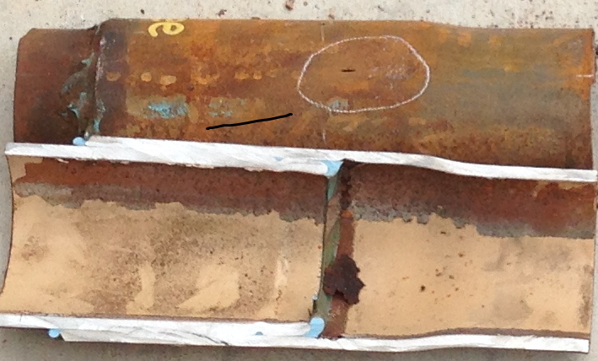
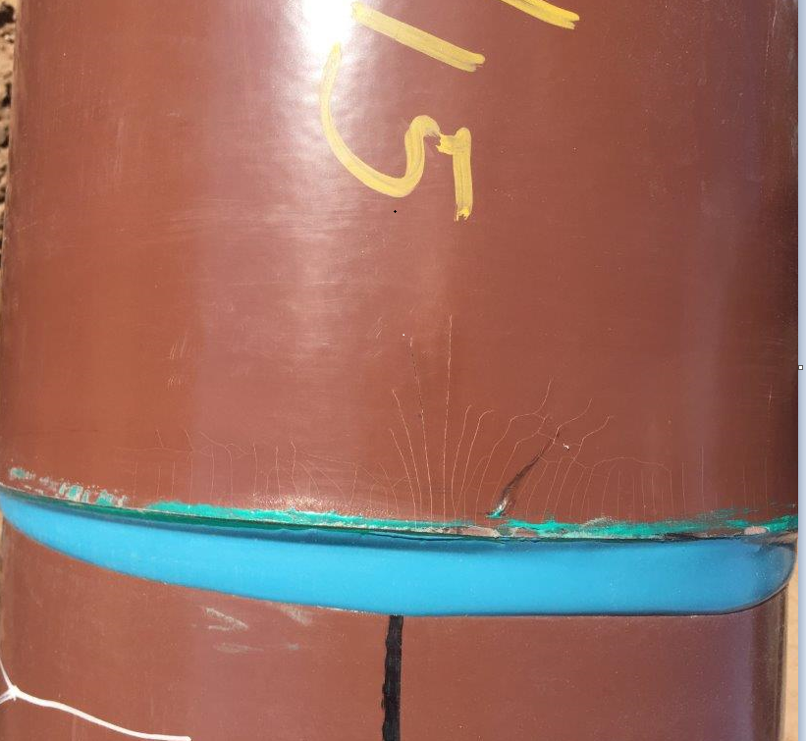
Key Points
Need to use reputable installer
Must have QA/QC program in place
Control of installation will avoid mishaps

Slide 24
Summary
Proven OXY experience in oil and gas and gas lines
Proven to 140% + of Actual Yield Strength
No field joint coating required
Pipe handling immediately after connection make-up
No reduction in internal diameter
Pipeline pigs can be used including ILI (South Texas ran baseline survey)
Electrical continuity through connections – No CP issues
Reduced health, safety and environmental risk – eliminate welding and joint coating
Reduced cost by 40% onshore, higher offshore

